Slide 1
Project Proposal
Interpretability in Machine Learning
João Monteiro fc49821
Filipe Sousa fc52748

Slide 2
Goal
Compare available Interpretability tools. (LIME & SHAP)
How different algorithms learn from the same data.

Slide 3
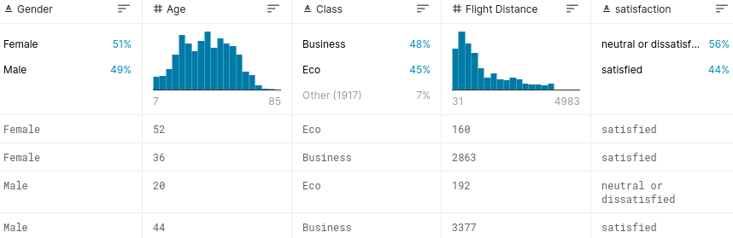
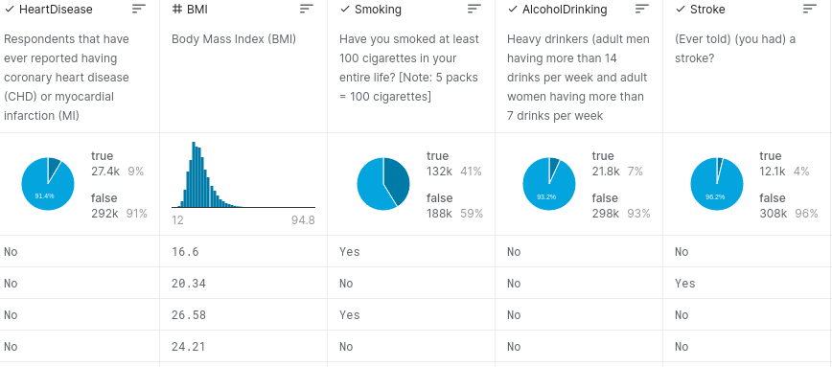
Datasets
Customer Satisfaction in an airline company
130k Observations;
1 Target feature (Satisfaction);
4 Continuous Features;
18 Categorical / Boolean Features.
Hearth Disease Key Indicators
320K Observations;
1 Target feature (If Has Heart Disease)
4 Continous Features;
13 Categorical / Boolean Features.

Slide 4
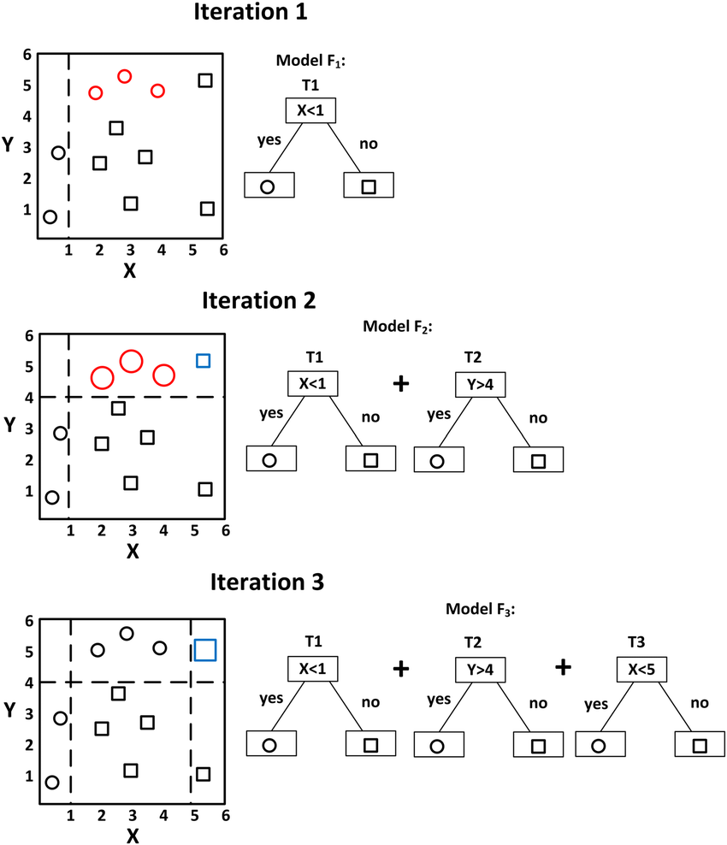
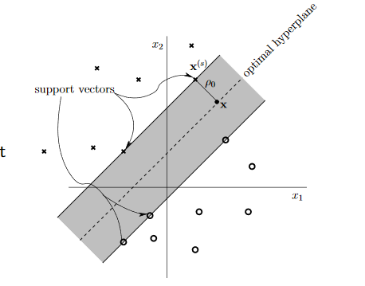
Machine Learning Algorithms
Support Vector Machines
Gradient Boosts

Slide 5
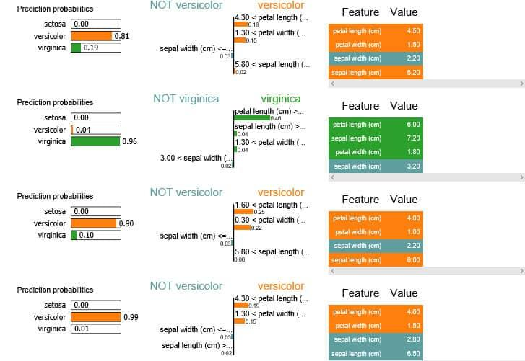
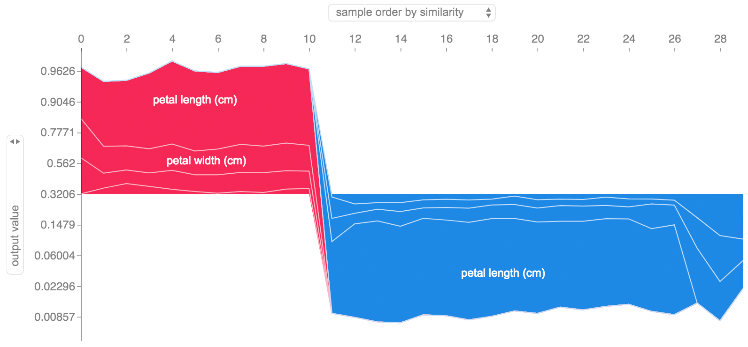
SHAP & LIME
LIME
(Local Interpretable Model-Agnostic Explanations)
SHAP
(Shapley Addictive Explanation)

